Slide 1
COMPANY PROFIT PREDICTION
BY VANKADARI SAI CHARITHA

Slide 2
CONTENTS
Introduction
Existing System
Proposed System
Algorithm
Implementation
Output
Conclusion

Slide 3
INTRODUCTION
A startup is a newly established company in which they have less amount of data regarding to the development of the company. Basic components of any startup such as Research and Development spend,Administration spend, Market spend these factors are common. With the help of this factors, we are predicting the profit. Building a profit prediction model helps an investor in various ways such as saving time and providing n an accuracy. Less amount time means an investor has required less amount of time to study performance of a company and profit. They just have to give simple inputs and they get easily prediction of a profit. In the term of accuracy models finds more accurate as it compares actual profit or predicting profit. Due to this it makes reliable model. Saving time of any individual is a great work, so we are trying to do it by our model and generating a reliable prediction model it makes more profitable work, it tends to investor make less amount of loss and save time to study about the company for investment

Slide 4
EXISTING SYSTEM
The existing system With the help of single independent variable like
investment cost of a company the profit of the company is predicted. Existing system uses linear regression for predicting the profit inwhich it uses single independent variable to predict the value of a dependent variable by building a regression line with the given data and therefore calculating dependent variable using with thatregression line. Other techniques also their such as Random Forest and Classification tree that uses lot of independent variables to predict the value of dependent variable but these techniques work best for
some given of them but not for all.

Slide 5
PROPOSED SYSTEM
The proposed system aims to develop an efficient and accurate profit prediction model for companies using machine learning techniques. The system will take financial expenditure inputs such as R&D Spend, Administration Cost, and Marketing Spend to predict the expected profit of a company. The proposed approach includes multiple regression models to identify the most suitable algorithm for accurate prediction.The system follows a structured workflow, beginning with data collection and preprocessing. The dataset is cleaned to handle missing values, remove outliers, and normalize numerical values to ensure consistency. The main task is to predict the value of predicted value as compared to the actual value (dependent variable). With the help of the dataset that belongs to the company previous performance. The techniques we are using gives us more accurate
result and the prediction of profit an average from all the predicted values of the dependent variable is figure out and get output as the predicted dependent variable.

Slide 6
ALGORITHM
Random Forest Regression is an ensemble learning technique that improves prediction accuracy by combining multiple decision trees. The methodology of Random Forest Regression for profit prediction consists of the following steps:
Data Preprocessing:
The dataset is cleaned, missing values are handled, and data is normalized to improve the model’s performance.
Feature Selection:
Important variables such as R&D Spend, Administration Cost, and Marketing Spend are selected as independent variables, while profit is the dependent variable.

Slide 7
Dataset Splitting:
The dataset is divided into training and testing sets to evaluate model performance effectively.
Model Training:
Multiple decision trees are created using different subsets of the dataset. Each tree is trained on a random sample using bootstrapping.
Prediction:
The Random Forest model aggregates predictions from all decision trees to determine the final output by averaging the predicted values.

Slide 8
Performance Evaluation:
The model's accuracy is assessed using metrics such as Mean Absolute Error (MAE), Mean Squared Error (MSE), and R-Squared Score (R²). Hyperparameter Tuning:
The number of trees (n_estimators), maximum depth, and other hyperparameters are optimized to enhance model accuracy.
Visualization:
Feature importance is analyzed using bar charts, and predicted vs. actual profit values are plotted to interpret model performance.

Slide 9
IMPLEMENTATION
By implementing Random Forest Regression, the proposed system enhances prediction reliability by reducing overfitting and improving accuracy through multiple decision trees. This methodology ensures that investors and stakeholders receive robust and precise profit predictions
Load the dataset and perform data cleaning.
Conduct Exploratory Data Analysis (EDA) to visualize correlations.
Split the dataset into training and testing sets.
Train multiple regression models including Random Forest Regression.
Evaluate model performance using regression metrics.

Slide 10
Optimize hyperparameters to improve accuracy.
Visualize results and compare models.
Select the best model for final profit prediction

Slide 11
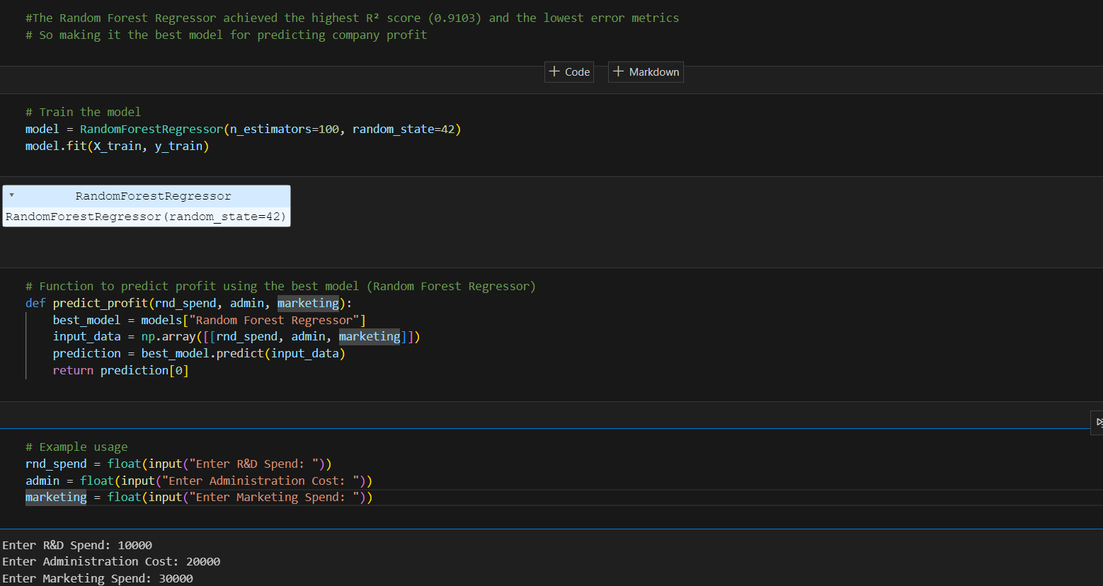
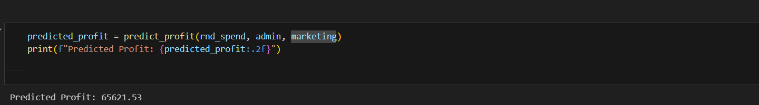
OUTPUT

Slide 12
Prediced Output

Slide 13
CONCLUSION
The profit prediction model developed in this study demonstrates the effectiveness of machine learning techniques in financial forecasting. By incorporating multiple regression models and Exploratory Data Analysis (EDA), the system provides accurate profit estimations based on financial expenditures. The findings highlight that R&D Spend significantly influences company profits, followed by Marketing Spend and Administration Cost. The implementation of ensemble methods like Random Forest Regression improves
prediction accuracy and reliability. This model serves as a valuable tool for investors and stakeholders, enabling data-driven investment decisions and minimizing financial risks.

